Slide 1
Emulator- Design and implementation decision support system for Workload Management

Slide 2
Motivation
Scientific experiments, such as Molecular Dynamics simulations, require large execution cost if done on a single computer system (even a single supercomputer takes 2 billion core hours for MD simulations).
Distribution of the work/experiments to multiple computer systems required to reduce the execution cost.
Organizations like Xsede have multiple resources with different properties: HETEROGENOUS.
Properties of a resource might also change over time: DYNAMIC.
Efficient execution of the experiment requires selection of viable resources: RESOURCE SELECTION.
Different tasks in an experiment can be mapped to competent resources that reduce overall execution cost: WORKLOAD MANAGEMENT
Emulator: provides an insight and act as a precursor for developing a workload management system that can be used in practice.

Slide 3
WLMS Emulator
Discusses WLM system with respect to three combinations:
Homogenous and static Workload, homogenous and static resources.
Homogenous and static Workload, homogeneous and dynamic resources.
Heterogenous and static Workload, homogenous and dynamic resources.
For the three combinations, uses two mapping & two binding techniques:
Random mapping
Task with longest execution time bound to resource that completes it first: L2FF mapping
Early binding
Late binding
Late binding of task with L2FF leads to minimum execution time for all the three cases.
As heterogeneity increases, there is in an increases in execution time. But late binding- L2FF still takes the least execution time.

Slide 4
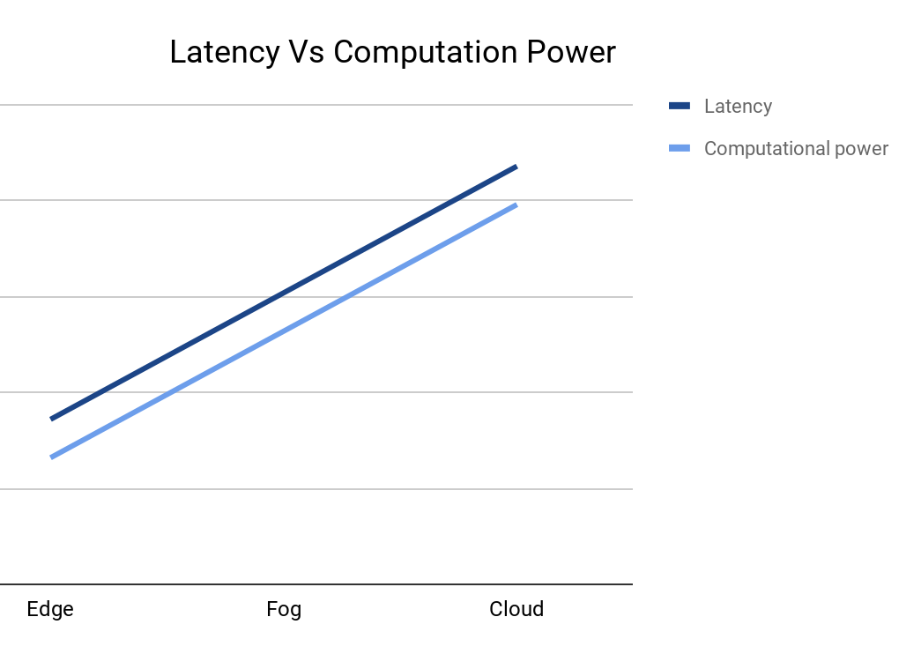
Definitions
Task: Stand-alone process that has well defined input, output, termination criteria, and resources requirements.
Workload: Set of tasks whose dependencies have been satisfied and can be concurrently executed.
Resource: A hardware system that can provide computational ability and storage memory.
Edge
Computation on devices generating the data
Can solve latency issues
Fog/Cloudlet
Brings computation power closer to the data creation
Cloud
Can solve scalability issues

Slide 5
Mathematical Modelling (min use-case)
Workload : { Task₁, Task₂, .................................. , Task_{n-1}, Task_{n} }
Resource : { Resource₁, Resource₂, ............................, Resource_{m-1}, Resource_{m}}
Algorithm : { Algorithm₁, Algorithm₂, ............................, Algorithm_{p-1}, Algorithm_{p}}
Algorithm_{K} : Task_{i} Resource_{j} , reducing the execution cost of the workload
Engine: Executes the selected schedule on the resources.

Slide 6
A simple implementation(min use-case)
For Instance,
Queue for Tasks based on task length:
Vivek’s uniform distribution
Priority Queue for Resources based on Computational Power:
Ming’s thesis:
Performance modelling, benchmarking, & execution time predictions → Grid
Queue waiting time → Supercomputers
Cost Formalism, Limited Information model & adapted match-making
Algorithm:
Longest Task mapped to the resource that completes the task fastest.
(Task₁, Resource₁)
Task₁
Task₂
Task₃
Task₄
Task₅
Task₆
Task₇
Resource₁
Resource₂
Resource₃
Resource₄
Resource₅
B
A

Slide 7
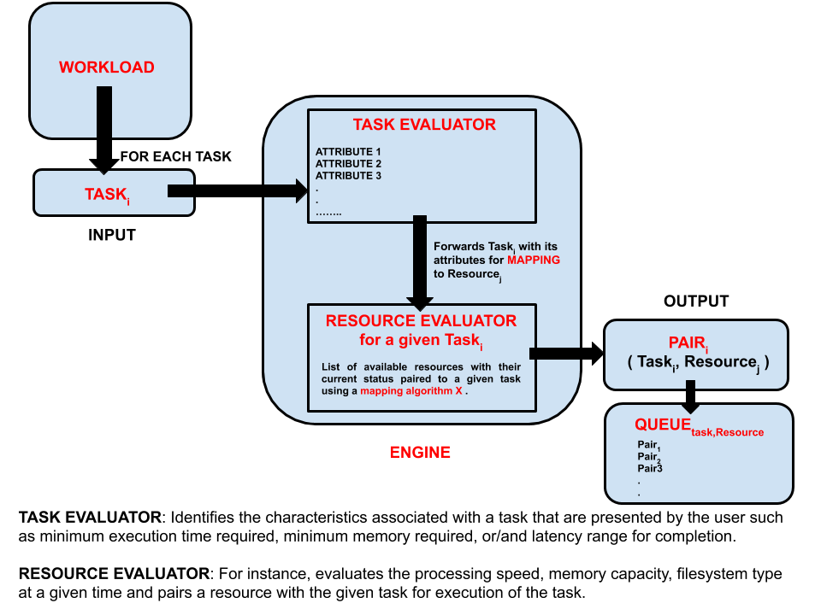
Reference Architecture

Slide 8
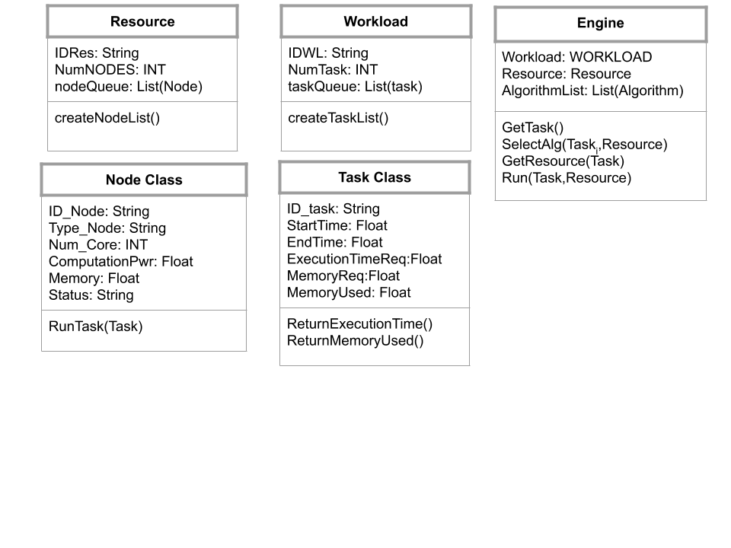
Emulator API - min-use case

Slide 9
RELATED WORK
IOTSim: A simulator for analysing IoT applications
Defines an Application model, Network and storage model, and Big Data Processing model.
Does not make a decision about the type of resource for each task that reduces the total execution time.
WLMS Emulator
Defines the two properties of resources and tasks - Heterogeneity and Dynamism
A late-binding strategy where scheduling decisions are delayed till the tasks need to be executed
Performance comparison between binding (Early and Late) task to a scheduler of the given resource.
Does not make a decision about the type of resource for each task that reduces the total execution time.
Baetyl

